Slide 1
ICT-LEARNFACTORY
Multi-User-Applikationen
objektorientiert realisieren
Informationssicherheit
08/16/26
Notes:
[Sources]
- Redesign follows the supplied ICT-LearnFactory Brand Guide (Aptos typography; Charcoal Flux #272726, Hyper Teal #45D9C7, Lumen Zest #D9EB12, Abyss Teal #29948C; geometric brand-mark pattern language).
- Slide content is preserved from the uploaded source presentation 09_Security.odp.
[/Sources]

Slide 2
Ziele
Du kennst das Schichtenmodell der Informationssicherheit
Du kennst den Unterschied zwischen Authorization und Authentication
Du kannst erklären, was Authorization und Authentication bedeuten
Du kennst das C.I.A. Dreieck
ICT-LEARNFACTORY
Security
Notes:
[Sources]
- Redesign follows the supplied ICT-LearnFactory Brand Guide (Aptos typography; Charcoal Flux #272726, Hyper Teal #45D9C7, Lumen Zest #D9EB12, Abyss Teal #29948C; geometric brand-mark pattern language).
- Slide content is preserved from the uploaded source presentation 09_Security.odp.
[/Sources]

Slide 3
Informationssicherheit
Daten sind schützenswerte Güter!
Der Zugriff auf sensible Daten sollte beschränkt und kontrolliert sein
Nur autorisierte Benutzer / Systeme dürfen auf die Daten zugreifen
Informationssicherheit ist eine grosse Herausforderung bei Multiuser-Applikationen
ICT-LEARNFACTORY
Security
Notes:
[Sources]
- Redesign follows the supplied ICT-LearnFactory Brand Guide (Aptos typography; Charcoal Flux #272726, Hyper Teal #45D9C7, Lumen Zest #D9EB12, Abyss Teal #29948C; geometric brand-mark pattern language).
- Slide content is preserved from the uploaded source presentation 09_Security.odp.
[/Sources]

Slide 4
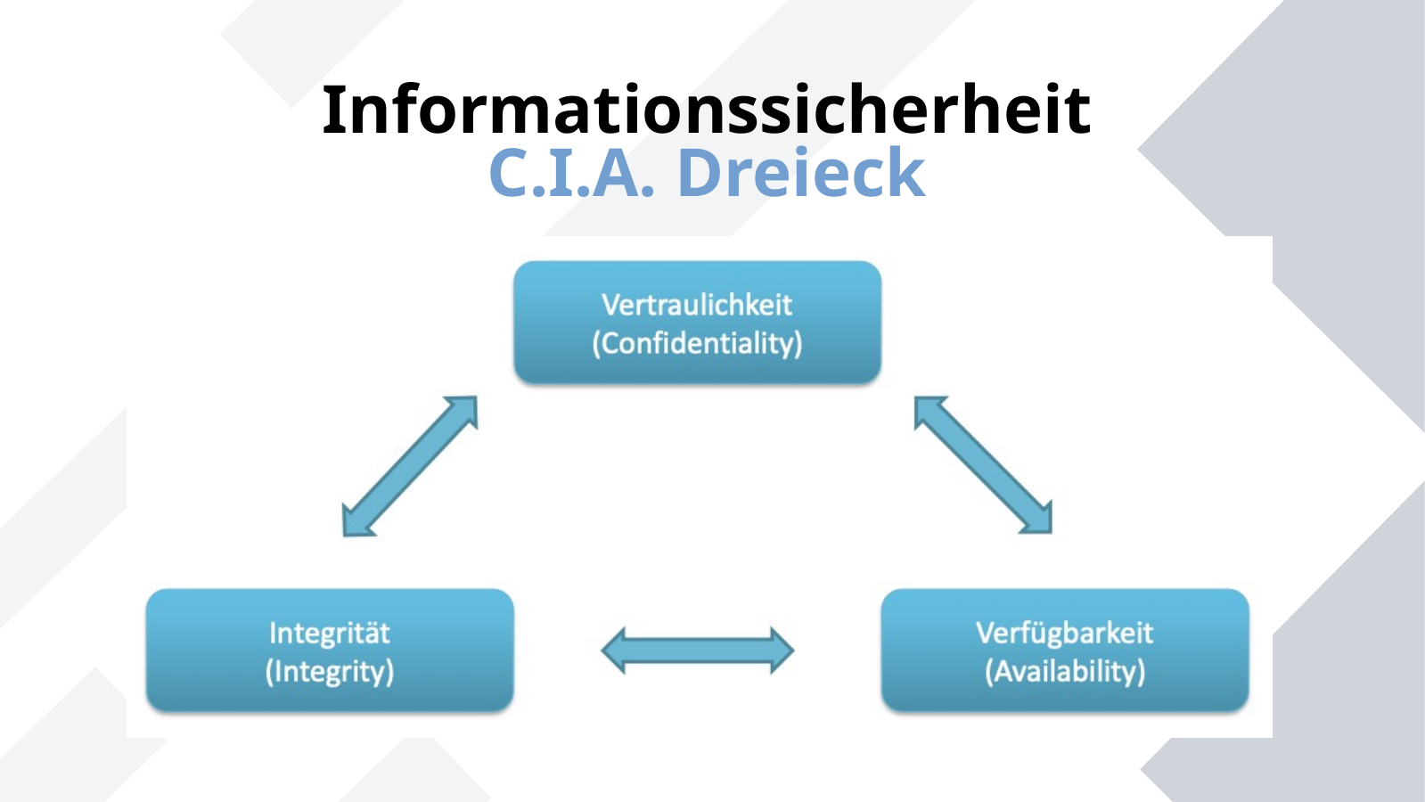
Informationssicherheit
C.I.A. Dreieck
ICT-LEARNFACTORY
Security
Notes:
[Sources]
- Redesign follows the supplied ICT-LearnFactory Brand Guide (Aptos typography; Charcoal Flux #272726, Hyper Teal #45D9C7, Lumen Zest #D9EB12, Abyss Teal #29948C; geometric brand-mark pattern language).
- Slide content is preserved from the uploaded source presentation 09_Security.odp.
[/Sources]

Slide 5
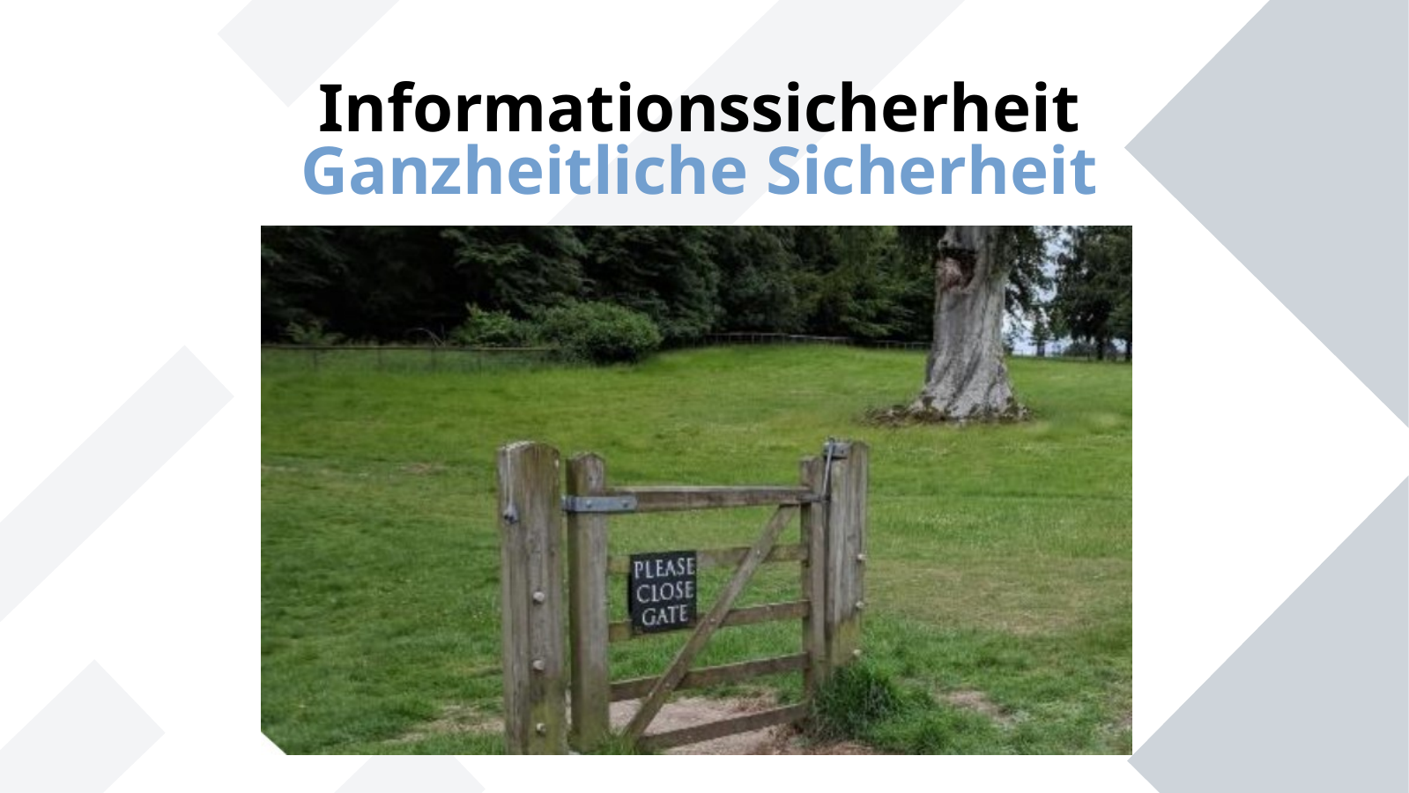
Informationssicherheit
Ganzheitliche Sicherheit
ICT-LEARNFACTORY
Security
Notes:
[Sources]
- Redesign follows the supplied ICT-LearnFactory Brand Guide (Aptos typography; Charcoal Flux #272726, Hyper Teal #45D9C7, Lumen Zest #D9EB12, Abyss Teal #29948C; geometric brand-mark pattern language).
- Slide content is preserved from the uploaded source presentation 09_Security.odp.
[/Sources]

Slide 6
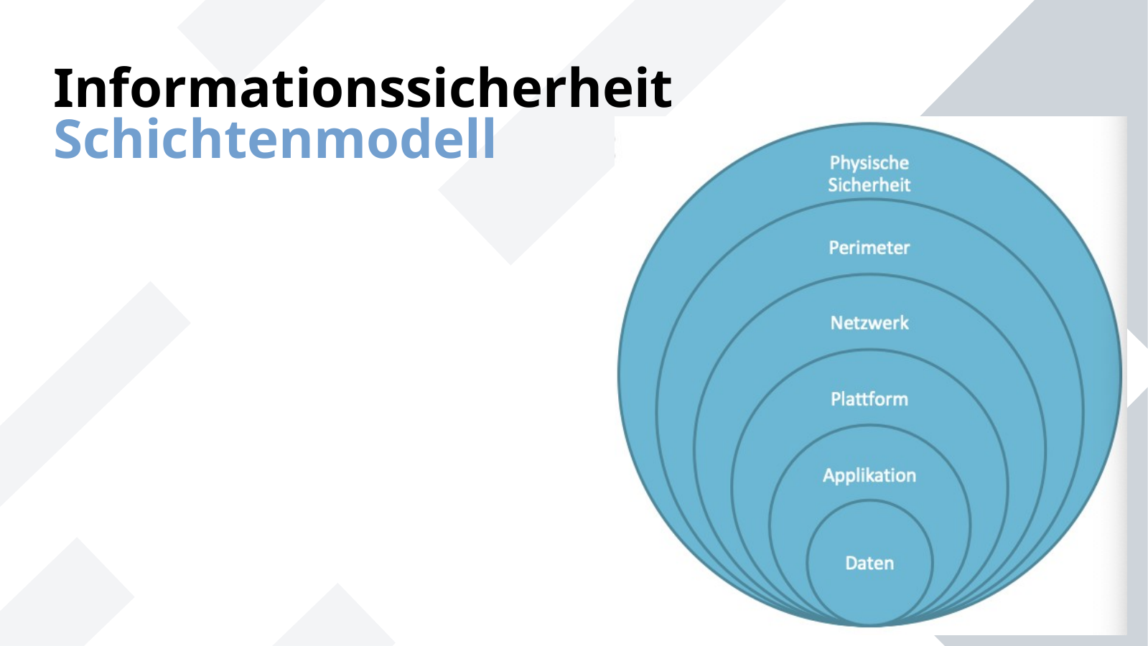
Informationssicherheit
Schichtenmodell
ICT-LEARNFACTORY
Security
Notes:
[Sources]
- Redesign follows the supplied ICT-LearnFactory Brand Guide (Aptos typography; Charcoal Flux #272726, Hyper Teal #45D9C7, Lumen Zest #D9EB12, Abyss Teal #29948C; geometric brand-mark pattern language).
- Slide content is preserved from the uploaded source presentation 09_Security.odp.
[/Sources]

Slide 7
Informationssicherheit
Schichtenmodell
Physische Sicherheit
Zugangskontrolle für Gebäude, Serverräume, etc.
Geräte trennen
Perimeter
Firewall, VPN, Router
Netzwerk
Netzwerk Segmente
ICT-LEARNFACTORY
Security
Notes:
[Sources]
- Redesign follows the supplied ICT-LearnFactory Brand Guide (Aptos typography; Charcoal Flux #272726, Hyper Teal #45D9C7, Lumen Zest #D9EB12, Abyss Teal #29948C; geometric brand-mark pattern language).
- Slide content is preserved from the uploaded source presentation 09_Security.odp.
[/Sources]

Slide 8
Informationssicherheit
Schichtenmodell
Plattform / Betriebssystem
Security Update Management, Anti-Virus, lokale Firewall, Zugriffsberechtigungen
Applikation
Sicherheitsstandards beim Programmieren beachten, Zugriffsberechtigungen
Datenschutz
Daten verschlüsseln, starke Passwörter, hashen
ICT-LEARNFACTORY
Security
Notes:
[Sources]
- Redesign follows the supplied ICT-LearnFactory Brand Guide (Aptos typography; Charcoal Flux #272726, Hyper Teal #45D9C7, Lumen Zest #D9EB12, Abyss Teal #29948C; geometric brand-mark pattern language).
- Slide content is preserved from the uploaded source presentation 09_Security.odp.
[/Sources]

Slide 9
Authentication
Nachweis / Verifizierung einer Echtheit einer Eigenschaft
Z.B. der Nachweis, dass jemand wirklich der ist für den er sich ausgibt.
Methoden:
Wissen (Passwort, PIN, Sicherheitsfrage)
Besitz (Karte, Schlüssel, Zertifikat)
Biometrie (Fingerabdruck, Gesichtserkennung, etc)
ICT-LEARNFACTORY
Security
Notes:
[Sources]
- Redesign follows the supplied ICT-LearnFactory Brand Guide (Aptos typography; Charcoal Flux #272726, Hyper Teal #45D9C7, Lumen Zest #D9EB12, Abyss Teal #29948C; geometric brand-mark pattern language).
- Slide content is preserved from the uploaded source presentation 09_Security.odp.
[/Sources]

Slide 10
Authorization
Welche Rechte hat ein authentifizierter Benutzer? / Was kann ein Benutzer tun?
Beispiel: User X darf die Operation Löschen der Resource Y ausführen
Kann z.B. pro Applikation, Formular oder Methode definiert werden
ICT-LEARNFACTORY
Security
Notes:
[Sources]
- Redesign follows the supplied ICT-LearnFactory Brand Guide (Aptos typography; Charcoal Flux #272726, Hyper Teal #45D9C7, Lumen Zest #D9EB12, Abyss Teal #29948C; geometric brand-mark pattern language).
- Slide content is preserved from the uploaded source presentation 09_Security.odp.
[/Sources]

Slide 11
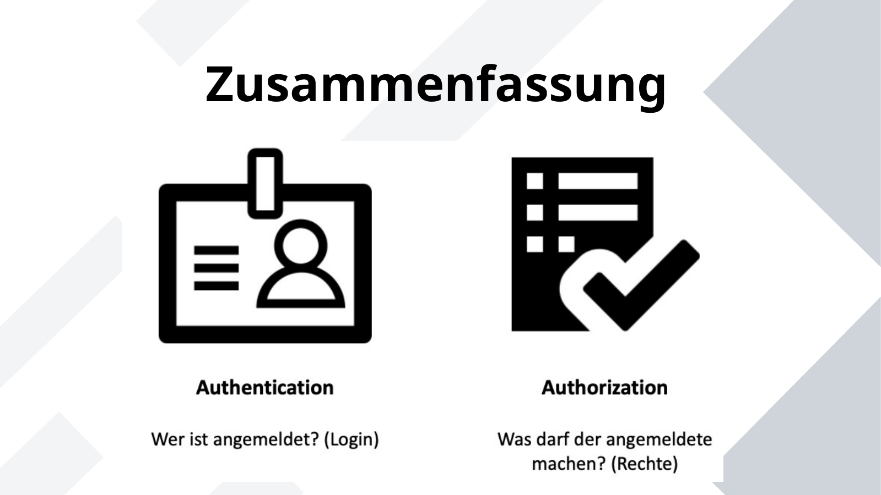
Zusammenfassung
ICT-LEARNFACTORY
Security
Notes:
[Sources]
- Redesign follows the supplied ICT-LearnFactory Brand Guide (Aptos typography; Charcoal Flux #272726, Hyper Teal #45D9C7, Lumen Zest #D9EB12, Abyss Teal #29948C; geometric brand-mark pattern language).
- Slide content is preserved from the uploaded source presentation 09_Security.odp.
[/Sources]

Slide 12
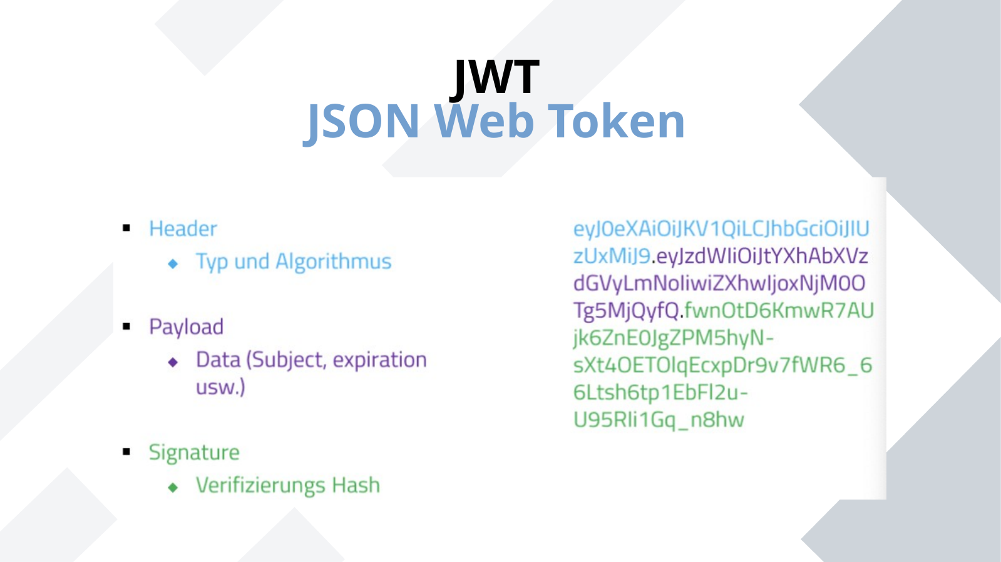
JWT
JSON Web Token
ICT-LEARNFACTORY
Security
Notes:
[Sources]
- Redesign follows the supplied ICT-LearnFactory Brand Guide (Aptos typography; Charcoal Flux #272726, Hyper Teal #45D9C7, Lumen Zest #D9EB12, Abyss Teal #29948C; geometric brand-mark pattern language).
- Slide content is preserved from the uploaded source presentation 09_Security.odp.
[/Sources]

Slide 13
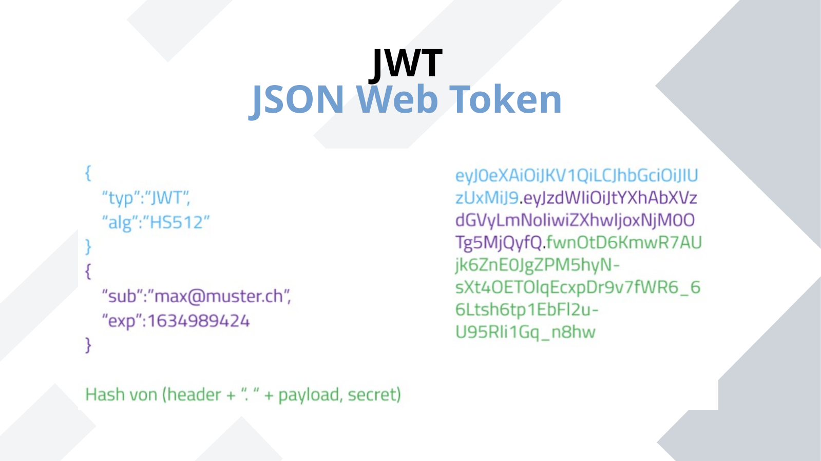
JWT
JSON Web Token
ICT-LEARNFACTORY
Security
Notes:
[Sources]
- Redesign follows the supplied ICT-LearnFactory Brand Guide (Aptos typography; Charcoal Flux #272726, Hyper Teal #45D9C7, Lumen Zest #D9EB12, Abyss Teal #29948C; geometric brand-mark pattern language).
- Slide content is preserved from the uploaded source presentation 09_Security.odp.
[/Sources]

Slide 14
Fragen?
ICT-LEARNFACTORY
Security
Notes:
[Sources]
- Redesign follows the supplied ICT-LearnFactory Brand Guide (Aptos typography; Charcoal Flux #272726, Hyper Teal #45D9C7, Lumen Zest #D9EB12, Abyss Teal #29948C; geometric brand-mark pattern language).
- Slide content is preserved from the uploaded source presentation 09_Security.odp.
[/Sources]

